Slide 1

GRADUATE SCHOOL OF BUSINESS
Introduction to Machine Learning Fall 2019 Dmitry Udler
Notes:
1
1

Slide 2
About the course
The goal of the course is to introduce the students to the main concepts of machine learning and provide working knowledge of tools available in the matlab Statistics and Machine Learning toolbox.
The emphasis will be on supervised learning, both classification and regression problems.
Major financial applications for such problems will be considered. Important ensemble methods (metaheuristics) for machine learning will be introduced.
Finally, students will get an initial insight on the foundations of neural networks methods, that will be fully covered in a more advanced course in Deep Learning.
2
Notes:
2
2
2

Slide 3
About the course
Instead of a standard text we will be using matlab documentation for the matlab Machine Learning and Statistics. It has a balanced mix of theory and practical guidance.
Additional text: J. Smith Machine Learning With Matlab: Supervised Learning and Regression”, Create Space Independent Publishing Platform, 2017.
Additional text: M. Paluszek and S. Thomas, “Matlab Machine Learning”, Apress, 2017, New Jersey.
Additional papers of interest will be on the BB.
Lectures every Thursday 1:15 to 3:15 pm.
Grading: 10% class participation and 90% homework.
3
Notes:
3
3
3

Slide 4
About the Instructor
Name: Dmitry Udler
Academic Degree: Ph. D. in Solid State Physics from the Academy of Sciences of former USSR (Chernogolovka/Moscow) 1988.
Academic history: Research professor, Dept. Of Materials Science and Engineering, Northwestern University, Evanston, IL , 1990-1996.
Financial employment: AIG FP, Citibank, Gen Re Securities, BlackRock, HSBC, JP Morgan Chase, Horton Point, Aladin Capital
Currently: KPMG Risk Advisory, New York.
4
Notes:
4
4
4

Slide 5
The purpose of this lecture
To discuss the main ideas of machine learning, its connections with other traditional areas, performance measurement and ensemble metaheurustics

Slide 6
Finance
What is finance all about?
What are main areas of finance?
What is the difference between financial markets and physical systems?

Slide 7
What is Machine Learning?
Machine learning is in fashion and subject to a lot of hype…
A question of what machine learning is hotly debated
The value of its definition is highly overrated – you can successfully use a method without being sure how this method is categorized

Slide 8
What is Machine Learning
Learning in a very general sense can be defined as “using experience to gain expertise”
For a long time psychologists have been trying to find out how people learn (with a primary purpose of making learning more efficient).
More generally, the question posed by biologists was: how living forms learn to survive? All kinds of experiments were conducted with rats, birds, insects etc.
With advent of digital computers obviously the question arose “can computers learn”
In the mindset of scientists of early computing error this was not a simple question. Why?
Early attempts, hype and disappointment (1960, perceptrons…)
New era (1990 and on)…

Slide 9
Goals of Machine Learning
When we say “to gain expertise”what exactly do we mean?
Suppose that we observe a quantitative response Y and p diﬀerent predictors, X₁,X₂,...,X_{p}. (also often called features). We assume that there is some relationship between Y and X =(X₁,X₂,...,X_{p}), which can be written in a very general form
Y = f(X)+ε
f(X) can be any deterministic function of X
ε is noise
To make it simple, when Y is a real number, we call it regression. When it is a discrete variable, we call it classification.
Discrete variables represent “labels”

Slide 10
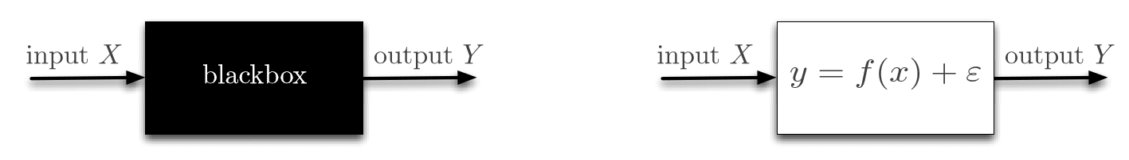
Machine learning Approach vs. Statistical Approach
The machine learning blackbox (left) where the goal is to replicate input/output pairs from past observations, versus the statistical approach that opens the blackbox and models the relationship.

Slide 11
Explanatory vs. Predictive Modeling
Explanatory modeling refers to the application of statistical models to data for testing causal hypotheses about theoretical constructs.
Predictive modeling as the process of applying a statistical model or data mining algorithm to data for the purpose of predicting new or future observations.
“A distinction without a difference”

Slide 12
Statistics and Machine Learning
The two ﬁelds share common goals. Indeed, both seem to try to use data to improve decisions.
While these ﬁelds have evolved in the same direction and currently share a lot of aspects, they were at the beginning quite diﬀerent.
Statistics was around much before machine learning and statistics was already a fully developed scientiﬁc discipline by 1920, most notably thanks to the contributions of R. Fisher, who popularized maximum likelihood estimation (MLE) as a systematic tool for statistical inference.
However, MLE requires essentially knowing the probability distribution from which the data is drawn, up to some unknown parameter of interest.
Often, the unknown parameter has a physical meaning and its estimation is key in better understanding some phenomena
Enabling MLE thus requires knowing a lot about the data generating process: this is known as modeling. Modeling can be driven by physics or prior knowledge of the problem. In any case, it requires quite a bit of domain knowledge.

Slide 13
Statistics and Machine Learning
Enabling MLE thus requires knowing a lot about the data generating process: this is known as modeling.
Modeling can be driven by some prior knowledge of the problem. In any case, it requires quite a bit of domain knowledge.
Phenomenological models
Calibration
Implied quantities

Slide 14
Statistics and Machine Learning
These diﬀerences between statistics and machine learning have receded over the last couple of decades.
Indeed, on the one hand, statistics is more and more concerned with ﬁnite sample analysis, model misspeciﬁcation and computational consideration
On the other hand, probabilistic modeling is now inherent to machine learning. At the intersection of the two ﬁelds, lies statistical learning theory, a ﬁeld which is primarily concerned with sample complexity questions, some of which will be the focus of this class.

Slide 15
How does financial ML differ from econometrics?
Econometrics is the application of classical statistical methods to economic and financial series. The essential tool of econometrics is multivariate linear regression.
Standard econometric models do not “learn”.

Slide 16
Supervised vs Unsupervised Learning
Supervised learning means that speciﬁc training sets of data are applied to the system.
The learning is supervised in that the “training sets” are human derived. It does not necessarily mean that humans are actively validating the results. The process of classifying the system’s outputs for a given set of inputs is called labeling. That is, you explicitly say which results are correct or which outputs are expected for each set of inputs.
The process of generating training sets can be time consuming. Great care must be taken to ensure that the training sets will provide sufﬁcient training so that when real-world data are collected the system will produce good results. They must cover the full range of expected inputs and desired outputs.
The training is followed by test sets to validate the results. If the results aren’t good, then the test sets are cycled into the training sets and the process repeated.

Slide 17
Unsupervised Learning
In contrast, unsupervised learning describes the somewhat more challenging situation in which for every observation i =1,...,n, we observe a vector of measurements x_{i} but no associated response y_{i}.
It is not possible to ﬁt a linear regression model, since there is no response variable to predict. In this setting, we are in some sense working blind; the situation is referred to as unsupervised because we lack a response variable that can supervise our analysis.
What sort of statistical analysis is possible? We can seek to understand the relationships between the variables or between the observations. One statistical learning tool that we may use in this setting is cluster analysis, or clustering.

Slide 18
Supervised vs. Unsupervised Learning
Another common application of unsupervised learning is outlier detection.
Can you suggest an example?

Slide 19
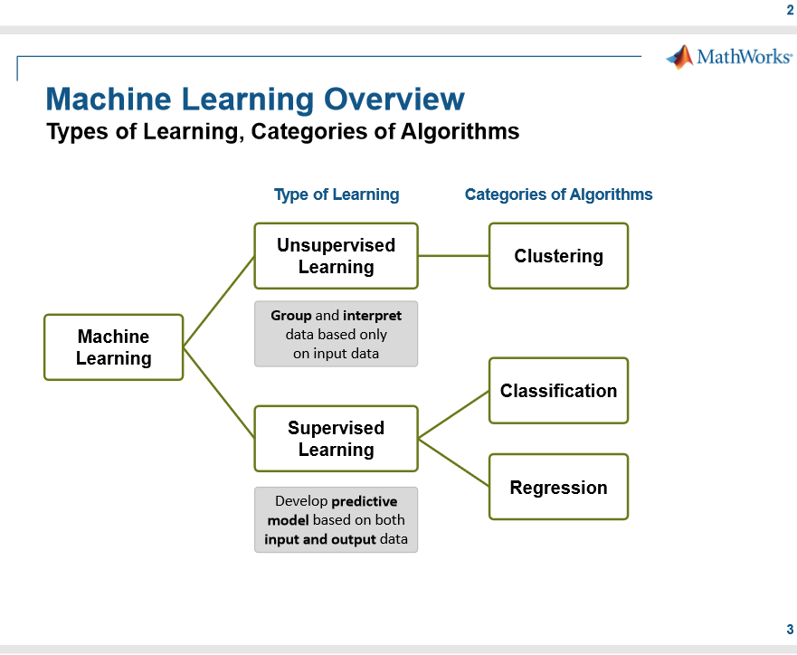

Slide 20
“Deep vs. Shallow” Learning
Essentially, neural networks vs. everything else…
Artificial Neural Networks (ANN) are arguably the most powerful learning algorithms, but they are also much fairly difficult to use.
Many practical problems in finance can be solved by simpler and more tractable methods like SVM and Decision Trees (in conjunction with ensemble methods)

Slide 21
Statistical Learning Theory
What can be learned efﬁciently?
What is inherently hard to learn?
A general model of learning?
Complexity
Computational complexity: time and space.
Sample complexity: amount of training data needed to learn successfully.
Mistake bounds: number of mistakes before learning successfully.

Slide 22
In-Sample vs Cross-validation vs Testing Set
The generalization performance of a learning method relates to its prediction capability on independent test data. Assessment of this performance is extremely important in practice, since it guides the choice of learning method or model, and gives us a measure of the quality of the ultimately chosen model.
Typically our model will have a tuning parameter or parameters α The tuning parameter varies the complexity of our model, and we wish to ﬁnd the value of α that optimizes out-of-sample performance.
It is important to note that there are in fact two separate goals that we might have in mind:
- Model selection: estimating the performance of diﬀerent models in order to choose the best one.
- Model assessment: having chosen a ﬁnal model, estimating its prediction error (generalization error) on new data.

Slide 23
In-Sample vs Cross-validation vs Testing Set
If we are in a data-rich situation, the best approach for both problems is to randomly divide the dataset into three parts:
-a training set,
- a validation set,
- a test set.
The training set is used to ﬁt the models; the validation set is used to estimate prediction error for model selection; the test set is used for assessment of the generalization error of the ﬁnal chosen model.
Ideally, the test set should be kept in a “vault,” and be brought out only at the end of the data analysis. Suppose instead that we use the test-set repeatedly, choosing the model with smallest test-set error. Then the test set error of the ﬁnal chosen model will underestimate the true test error, sometimes substantially. It is diﬃcult to give a general rule on how to choose the number of observations in each of the three parts. A typical split might be 50% for training, and 25% each for validation and testing:

Slide 24
In-Sample vs Cross-validation vs Testing Set
Ideally, if we had enough data, we would set aside a validation set and use it to assess the performance of our prediction model. Since data are often scarce, this is usually not possible.
To ﬁnesse the problem, K-fold cross-validation uses part of the available data to ﬁt the model, and a diﬀerent part to test it. We split the data into K roughly equal-sized parts (though bootstrapping) ; for example, when K = 5, the scenario looks like this:
1. Divide the samples into K cross-validation folds (groups) at random.
2. For each fold k = 1,2,...,K
Find a subset of “good” predictors that show fairly strong (univariate) correlation with the class labels, using all of the samples except those in fold k.
(b) Using just this subset of predictors, build a multivariate classiﬁer, using all of the samples except those in fold k.
(c) Use the classiﬁer to predict the class labels for the samples in fold k.
Performance measures are aggregated across all folds.

Slide 25
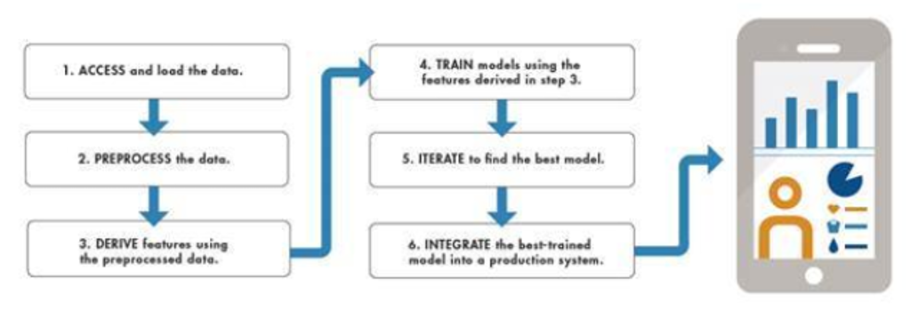
Machine Learning Workflow

Slide 26
Performance Measure (metric) and Loss Function
Machine learning models are mostly trained using gradient methods by an iterative process of decreasing a loss function. The loss function is designed to have two crucial properties - that the less its value is - the better your model fits your data and it should be differentiable. So - knowing this we could fully define what a metric is: it's a function that given predicted values and true values of examples provide you with a scalar measure of a fit of your model to data you have.
So as you may see a loss function is metric but the opposite doesn't always hold. The most common examples of metrics usage are:
1. Measure a performance of your network using non-differentiable functions: e.g. accuracy is not differentiable (not even continuous) so you cannot directly optimize your model w.r.t. to it. However - you could use it in order to choose the model with the best accuracy.
2. Track a measure with respect to which you don't want to directly optimize your model.

Slide 27

Learning Performance - MAPE
Mean absolute percentage error
A_{t} is the actual value and F_{t} is the forecast value.
It cannot be used if there are zero values because there would be a division by zero.
When MAPE is used to compare the accuracy of prediction methods it is biased in that it will systematically select a method whose forecasts are too low. This little-known but serious issue can be overcome by using an accuracy measure based on the ratio of the predicted to actual value (called the Accuracy Ratio), this approach leads to superior statistical properties and leads to predictions which can be interpreted in terms of the geometric mean.

Slide 28

Learning Performance – Classification
Classification Accuracy is what we usually mean, when we use the term accuracy. It is the ratio of number of correct predictions to the total number of input samples.
It works well only if there are equal number of samples belonging to each class.
For example, consider that there are 98% samples of class A and 2% samples of class B in our training set. Then our model can easily get 98% training accuracy by simply predicting every training sample belonging to class A.
When the same model is tested on a test set with 60% samples of class A and 40% samples of class B, then the test accuracy would drop down to 60%. Classification Accuracy is great, but gives us the false sense of achieving high accuracy.

Slide 29
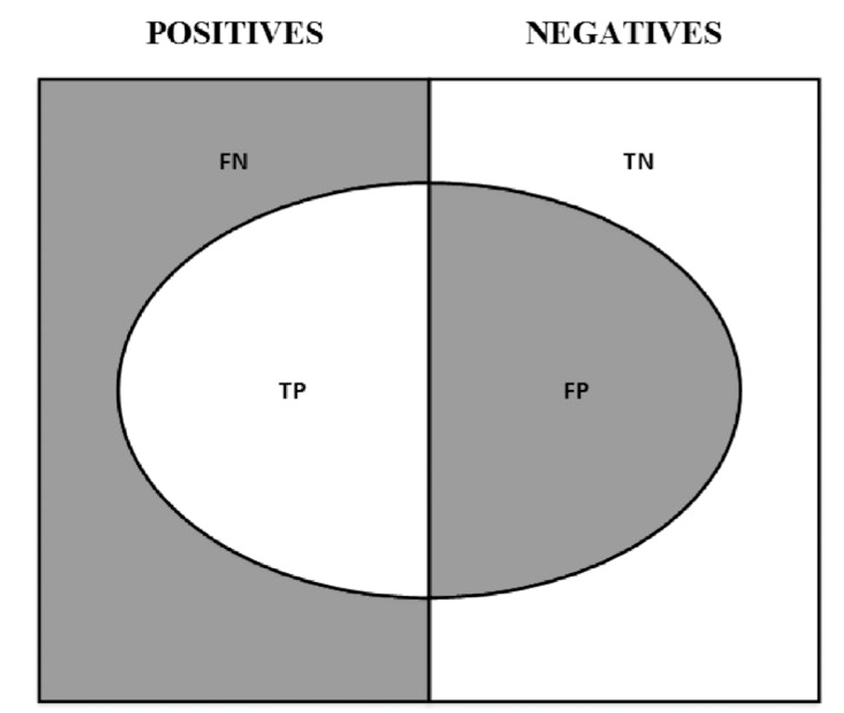
Learning Performance – Confusion Matrix

Slide 30
Learning Performance – Confusion Matrix
On a set of observations, there are items that exhibit a condition (positives, left rectangle), and items that do not exhibit a condition (negative, right rectangle). A binary classifier predicts that some items exhibit the condition (ellipse), where the TP area contains the true positives and the TN area contains the true negatives. This leads to two kinds of errors: false positives (FP) and false negatives (FN). “Precision” is the ratio between the TP area and the area in the ellipse. “Recall” is the ratio between the TP area and the area in the left rectangle. This notion of recall (aka true positive rate) is in the context of classification problems, the analogous to “power” in the context of hypothesis testing. “Accuracy” is the sum of the TP and TN areas divided by the overall set of items (square). In general, decreasing the FP area comes at a cost of increasing the FN area. Still, there is some combination of precision and recall that maximizes the overall efficiency of the classifier.

Slide 31
Learning Performance - ROC
ROC curve (Receiver Operating Characteristics Curve) is another metrics to measure the performance of a classifier model, ROC curve depicts the locus of rate of true positives with respect to rate of false positives, this highlights the sensitivity of the classifier model.
The ideal classifier will have an ROC where the graph would hit a true positive rate of 100% with zero development of x-axis (false positives). Since that is improbable in reality, we measure how many correct positive classifications are being gained with increment in rate of false positives.

Slide 32
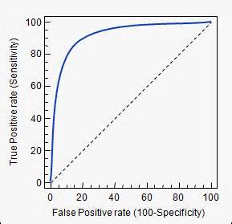
Learning Performance - ROC
Area under the ROC curve is a good way to estimate the accuracy of the model. Because an ideal ROC curve will have lot more AUC (Area Under Curve) than compared to poor classifier’s ROC.

Slide 33
Loss function
All the algorithms in machine learning rely on minimizing or maximizing a function, which we call “objective function”. The group of functions that are minimized are called “loss functions”. A loss function is a measure of how good a prediction model does in terms of being able to predict the expected outcome.
Since the loss function needs to be optimized, its properties wrt optimization: number of extrema, ease of optimization, etc. are extremely important.
There is not a single loss function that works for all kind of data. It depends on a number of factors including the presence of outliers, choice of machine learning algorithm, etc.

Slide 34
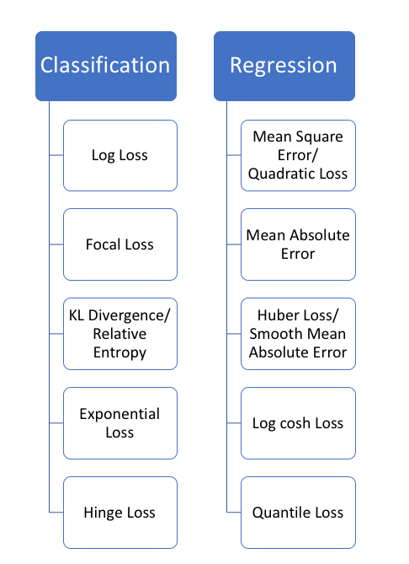
Loss function

Slide 35
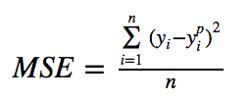
Regression loss functions
Mean Square Error, Quadratic loss, L2 Loss
Mean Square Error (MSE) is the most commonly used regression loss function. MSE is the sum of squared distances between our target variable and predicted values.

Slide 36
Regression loss functions
Mean Absolute Error, L1 Loss
Mean Absolute Error (MAE) is another loss function used for regression models. MAE is the sum of absolute differences between our target and predicted variables. So it measures the average magnitude of errors in a set of predictions, without considering their directions. (If we consider directions also, that would be called Mean Bias Error (MBE), which is a sum of residuals/errors). The range is also 0 to ∞.

Slide 37
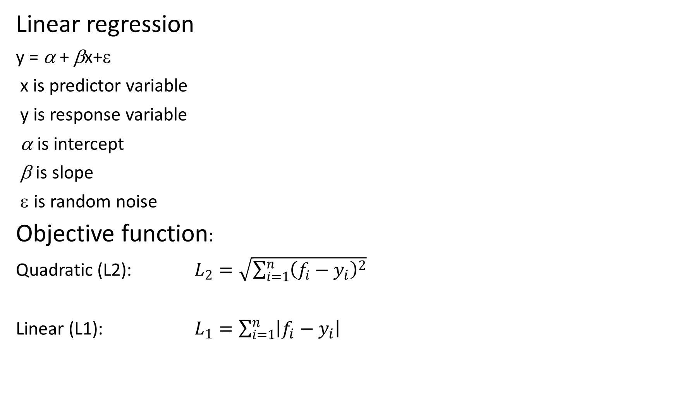
Regression
Linear regression
y = α + βx+ε
x is predictor variable
y is response variable
α is intercept
β is slope
ε is random noise
Objective function:
Quadratic (L2): $L_{2}=\sqrt{\sum_{i=1}^{n}{{\left(f_{i}−y_{i}\right)}^{2}}}$
Linear (L1): $L_{1}=\sum_{i=1}^{n}{\left|f_{i}−y_{i}\right|}$

Slide 38
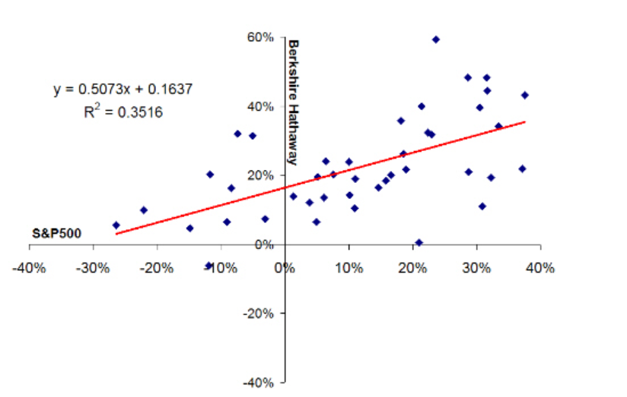

Regression
Example
Performance measurement of investment: alpha and beta
$$R_{p}−R_{f}=α+β\left(R_{m}−R_{f}\right)+ε$$

Slide 39
Regression loss functions
MSE vs. MAE (L2 loss vs L1 loss)
In short, using the squared error is easier to solve, but using the absolute error is more robust to outliers. But let’s understand why!
Intuitively, we can think about it like this: If we only had to give one prediction for all the observations that try to minimize MSE, then that prediction should be the mean of all target values. But if we try to minimize MAE, that prediction would be the median of all observations. We know that median is more robust to outliers than mean, which consequently makes MAE more robust to outliers than MSE.

Slide 40
Regression loss functions
Problems with both: There can be cases where neither loss function gives desirable predictions. For example, if 90% of observations in our data have true target value of 150 and the remaining 10% have target value between 0–30. Then a model with MAE as loss might predict 150 for all observations, ignoring 10% of outlier cases, as it will try to go towards median value. In the same case, a model using MSE would give many predictions in the range of 0 to 30 as it will get skewed towards outliers. Both results are undesirable in many business cases.
What to do in such a case? An easy fix would be to transform the target variables. Another way is to try a different loss function. This is the motivation behind Huber loss.

Slide 41

Regression loss
Huber Loss, Smooth Mean Absolute Error
Huber loss is less sensitive to outliers in data than the squared error loss. It’s also differentiable at 0. It’s basically absolute error, which becomes quadratic when error is small. How small that error has to be to make it quadratic depends on a hyperparameter, 𝛿 (delta), which can be tuned. Huber loss approaches MAE when 𝛿 ~ 0 and MSE when 𝛿 ~ ∞ (large numbers.)

Slide 42

Regression loss functions
Log-Cosh Loss
Log-cosh is another function used in regression tasks that’s smoother than L2. Log-cosh is the logarithm of the hyperbolic cosine of the prediction error.
Log-cosh works mostly like the mean squared error, but will not be so strongly affected by the occasional wildly incorrect prediction. It has all the advantages of Huber loss, and it’s twice differentiable everywhere, unlike Huber loss.

Slide 43
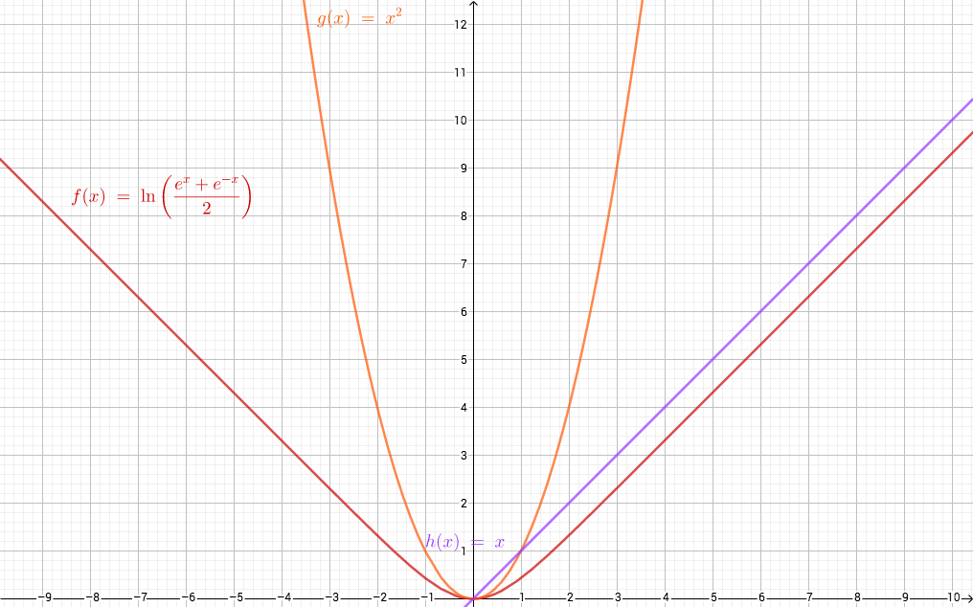
Log-Cosh function

Slide 44
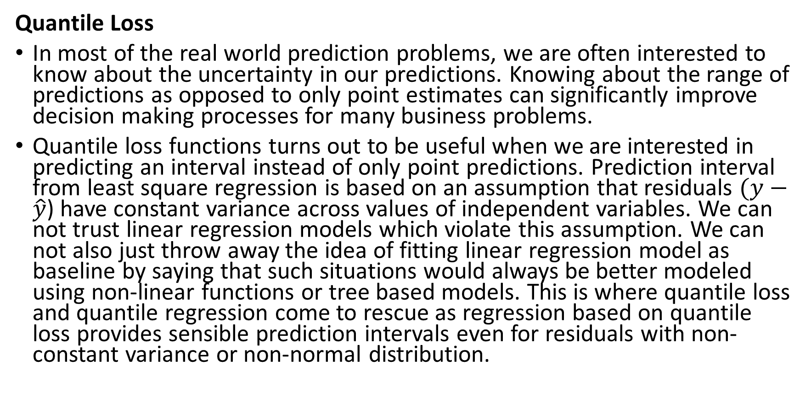
Regression loss
Quantile Loss
In most of the real world prediction problems, we are often interested to know about the uncertainty in our predictions. Knowing about the range of predictions as opposed to only point estimates can significantly improve decision making processes for many business problems.
Quantile loss functions turns out to be useful when we are interested in predicting an interval instead of only point predictions. Prediction interval from least square regression is based on an assumption that residuals $(y−\hat{y}$) have constant variance across values of independent variables. We can not trust linear regression models which violate this assumption. We can not also just throw away the idea of fitting linear regression model as baseline by saying that such situations would always be better modeled using non-linear functions or tree based models. This is where quantile loss and quantile regression come to rescue as regression based on quantile loss provides sensible prediction intervals even for residuals with non-constant variance or non-normal distribution.

Slide 45

Regression loss
Quantile-based regression aims to estimate the conditional “quantile” of a response variable given certain values of predictor variables. Quantile loss is actually just an extension of MAE (when quantile is 50th percentile, it’s MAE).
The idea is to choose the quantile value based on whether we want to give more value to positive errors or negative errors. Loss function tries to give different penalties to overestimation and underestimation based on the value of chosen quantile (γ). For example, a quantile loss function of γ = 0.25 gives more penalty to overestimation and tries to keep prediction values a little below median

Slide 46
Classification loss functions
Likelihood Loss
The likelihood loss function is relatively simple and is commonly used in classification problems. The function takes the predicted probability for each input example and multiplies them. And although the output isn’t exactly human interpretable, it’s useful for comparing models.
For example, consider a model that outputs probabilities of [0.4, 0.6, 0.9, 0.1] for the true labels of [0, 1, 1, 0]. The likelihood loss would be computed as (0.6) * (0.6) * (0.9) * (0.9) = 0.2916. Since the model outputs probabilities for TRUE (or 1) only, when the true label is 0 we take (1-p) as the probability. In other words, we multiply the model’s outputted probabilities together for the actual outcomes.

Slide 47
Classification loss functions
Log Loss (Cross Entropy Loss)
Log Loss is a loss function also used frequently in classification problems, and is one of the most popular measures for Kaggle competitions. It’s just a straightforward modification of the likelihood function with logarithms.
This is actually exactly the same formula as the regular likelihood function, but with logarithms added in. You can see that when the actual class is 1, the second half of the function disappears, and when the actual class is 0 the first half drops. That way, we just end up multiplying the log of the actual predicted probability for the true class.

Slide 48
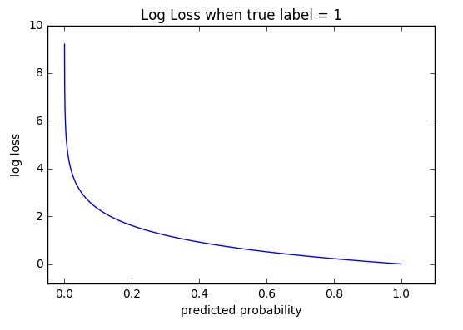
Classification loss functions
Log Loss (Cross Entropy Loss)
The cool thing about the log loss function is that is has a kick: it penalizes heavily for being very confident and then very wrong. Predicting high probabilities for the wrong class makes the function go crazy. The graph below is for when the true label =1, and you can see that it skyrockets as the predicted probability for label = 0 approaches 1.

Slide 49
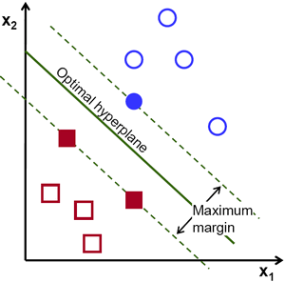
Classification loss functions
Hinge Loss
The (L2-regularized) hinge loss leads to the canonical support vector machine model with the max-margin property: the margin is the smallest distance from the line (or more generally, hyperplane) that separates our points into classes and defines our classification:

Slide 50

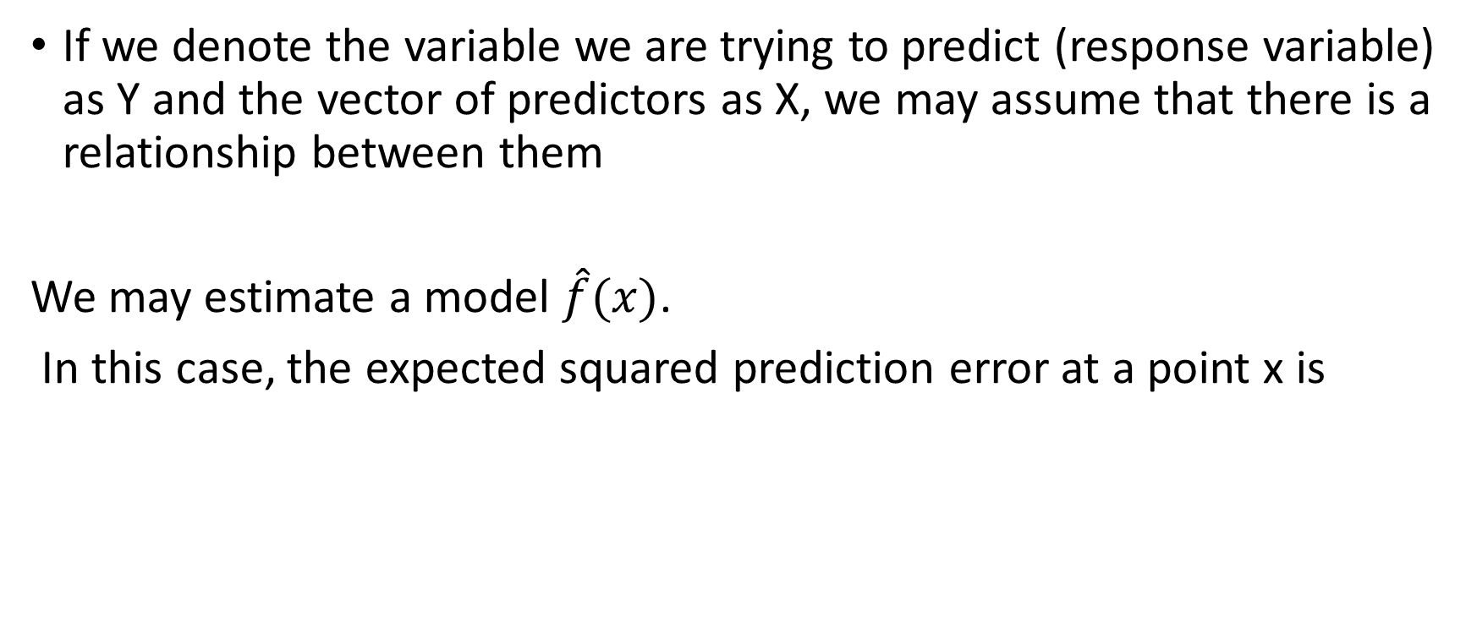
Sources of Error in Machine Learning
If we denote the variable we are trying to predict (response variable) as Y and the vector of predictors as X, we may assume that there is a relationship between them
We may estimate a model $\hat{f}(x)$.
In this case, the expected squared prediction error at a point x is

Slide 51
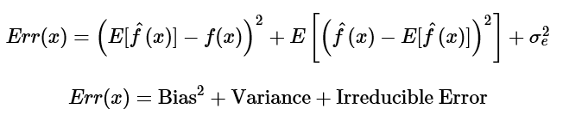
Sources of Error in Machine Learning
This error may then be decomposed into bias and variance components:
That third term, irreducible error, is the noise term in the true relationship that cannot fundamentally be reduced by any model. Given the true model and infinite data to calibrate it, we should be able to reduce both the bias and variance terms to 0. However, in a world with imperfect models and finite data, there is a tradeoff between minimizing the bias and minimizing the variance.

Slide 52
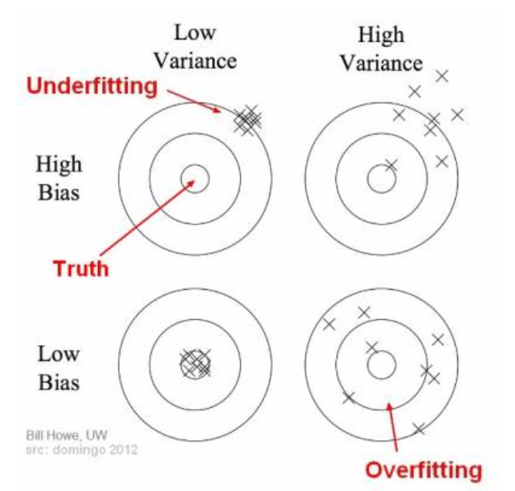
Bias and variance using bulls-eye diagram

Slide 53
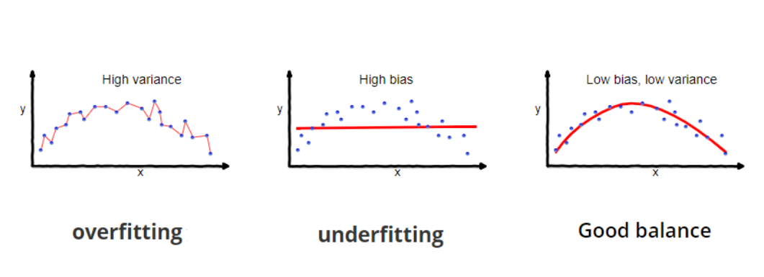
Bias and Variance

Slide 54
Bias and Variance
In supervised learning, underfitting happens when a model is unable to capture the underlying pattern of the data. These models usually have high bias and low variance. It happens when we have very less amount of data to build an accurate model or when we try to build a linear model with a nonlinear data. Also, these kind of models are very simple to capture the complex patterns in data like Linear and logistic regression.
In supervised learning, overfitting happens when our model captures the noise along with the underlying pattern in data. It happens when we train our model a lot over noisy dataset. These models have low bias and high variance. These models are very complex like Decision trees which are prone to overfitting.

Slide 55
Machine Learning
A gut feeling for people have done a lot of Monte Carlo is that they should minimize bias even at the expense of variance. The thinking goes that the presence of bias indicates something basically wrong with their model and algorithm. Yes, they acknowledge, variance is also bad but a model with high variance could at least predict well on average, at least it is not fundamentally wrong.
This is mistaken logic. It is true that a high variance and low bias model can preform well in some sort of long-run average sense. However, in practice modelers are always dealing with a single realization of the data set. In these cases, long run averages are irrelevant, what is important is the performance of the model on the data you actually have and in this case bias and variance are equally important and one should not be improved at an excessive expense to the other.

Slide 56
Machine Learning
At its root, dealing with bias and variance is really about dealing with over- and under-fitting. Bias is reduced and variance is increased in relation to model complexity. Complexity can be defined in many ways, but the simplest one is the number of model parameters. As more and more parameters are added to a model, the complexity of the model increases and variance becomes our primary concern while bias steadily falls.

Slide 57

Bias and Variance Trade-off
The best trade-off for any model is the level of complexity at which the increase in bias is equivalent to the reduction in variance.

Slide 58
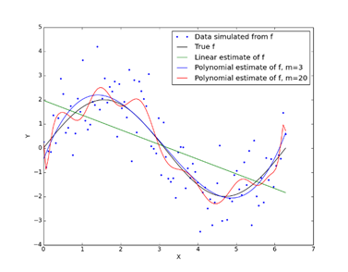
Bias/Variance Trade-off
Models that fit the data poorly have high bias: “Inflexible models” such as linear regression.
Models that can fit the data very well have low bias but high variance: “flexible” ”models.

Slide 59
Machine Learning Workflow

Slide 60
Ensemble Methods (Metaheuristics)
An ensemble method is a method that combines a set of weak learners, all based on the same learning algorithm, in order to create a (stronger) learner that performs better than any of the individual ones. Ensemble methods help reduce bias and/or variance.

Slide 61
Bagging aka Bootstrap Aggregation
Bootstrap aggregation (bagging) is an effective way of reducing the variance in forecasts. It works as follows:
First, generate N training datasets by random sampling with replacement.
Second, fit N estimators, one on each training set. These estimators are fit independently from each other, hence the models can be fit in parallel.
Third, the ensemble forecast is the simple average of the individual forecasts from the N models. In the case of categorical variables, the probability that an observation belongs to a class is given by the proportion of estimators that classify that observation as a member of that class (majority voting).

Slide 62
Bagging
When a regression method or a classiﬁer has a tendency to overﬁt, bagging reduces the variance of the prediction. It cannot reduce the bias.

Slide 63
Boosting
First, generate one training set by random sampling with replacement, according to some sample weights (initialized with uniform weights).
Second, fit one estimator using that training set.
Third, if the single estimator achieves an accuracy greater than the acceptance threshold (e.g., 50% in a binary classifier, so that it performs better than chance), the estimator is kept, otherwise it is discarded.
Fourth, give more weight to misclassified observations, and less weight to correctly classified observations.
Fifth, repeat the previous steps until N estimators are produced. Sixth, the ensemble forecast is the weighted average of the individual forecasts from the N models, where the weights are determined by the accuracy of the individual estimators.

Slide 64
Boosting
A few aspects make boosting quite different from bagging
Individual classifiers are fit sequentially.
Poor-performing classifiers are dismissed.
Observations are weighted differently in each iteration.
The ensemble forecast is a weighted average of the individual learners.

Slide 65
Boosting
Boosting's main advantage is that it reduces both variance and bias in forecasts.
However, correcting bias comes at the cost of greater risk of overfitting. It could be argued that in financial applications bagging is generally preferable to boosting.
Bagging addresses overfitting, while boosting addresses underfitting. Overfitting is often a greater concern than underfitting, as it is not difficult to overfit an ML algorithm to financial data, because of the low signal-to-noise ratio.
Furthermore, bagging can be parallelized, while generally boosting requires sequential running.

Slide 66
Why matlab?
There are many computing environments (some free, some paid):
Python, R, SAS, Mathematica,…
Features to consider:
A good selection of well documented machine learning algorithms
Ease of use
Good graphics
Good interface with other environments
Support

Slide 67
Regression Learner
The Regression Learner app trains regression models to predict data. Using this app, you can explore your data, select features, specify validation schemes, train models, and assess results. You can perform automated training to search for the best regression model type, including linear regression models, regression trees, Gaussian process regression models, support vector machines, and ensembles of regression trees.
Perform supervised machine learning by supplying a known set of observations of input data (predictors) and known responses. Use the observations to train a model that generates predicted responses for new input data. To use the model with new data, or to learn about programmatic regression, you can export the model to the workspace or generate MATLAB® code to recreate the trained model.

Slide 68
Classification Learner
The Classification Learner app trains models to classify data. Using this app, you can explore supervised machine learning using various classifiers. You can explore your data, select features, specify validation schemes, train models, and assess results. You can perform automated training to search for the best classification model type, including decision trees, discriminant analysis, support vector machines, logistic regression, nearest neighbors, and ensemble classification.
You can perform supervised machine learning by supplying a known set of input data (observations or examples) and known responses to the data (e.g., labels or classes). You use the data to train a model that generates predictions for the response to new data. To use the model with new data, or to learn about programmatic classification, you can export the model to the workspace or generate MATLAB® code to recreate the trained model.

Slide 69
Matlab Practice (no machine learning)
J. Kienitz and D. Wetterau “Financial modelling: Theory, Implementation and Practice with Matlab Code”, Wiley, 2012, Ch. 11 and 12.
M. Gilli and D. Maringer, “Numerical Methods and Optimization in Finance”, Academic Press, 2011.
J. Danielsson, “Financial Risk Forecasting: The Theory and Practice of Forecasting Market Risk with Implementation in R and Matlab”, Wiley, 2011

Slide 70
Example
creditDS = readtable('CreditRating_Historical.dat');

